Slide 1
Volume and Weight of Soil
Ankan Basu, CPG

Slide 2
Find the volume of weight of soil contaminated by a chemical spill
Problem presented in Hydrogeology and Groundwater Modeling book by Neven Kresic.
I am going to produce a simplified version of the problem.
I will sue SURFER DEMO version. It can be used to create grids and perform volume calculations.
You can use other software such as CARLSON for volume calculations also.

Slide 3
Provided information
XYZ database for soil borings.
Soil is composed of Kaolinite (65%), K-Feldspar (20%) and quartz (15%).
Average soil porosity= 14%
Saturation Index=22%

Slide 4
Goal
Calculate volume of contaminated soil.
Use software to create grids for surfaces of interest
Calculate volume between the grids.
SURFER is used for the exercise.
Assumption: Every bit of contaminated soil must be removed.

Slide 5
Steps
Prepare spreadsheet or a text (ASCII) file.
Import database to SURFER / CARLSON
Create grid for top surface
Create grid for bottom surface
Create a grid for TOP-BOTTOM Grid.
Perform volume calculation from 0 elevation and the (TOP-BOTTOM) Grid.

Slide 6
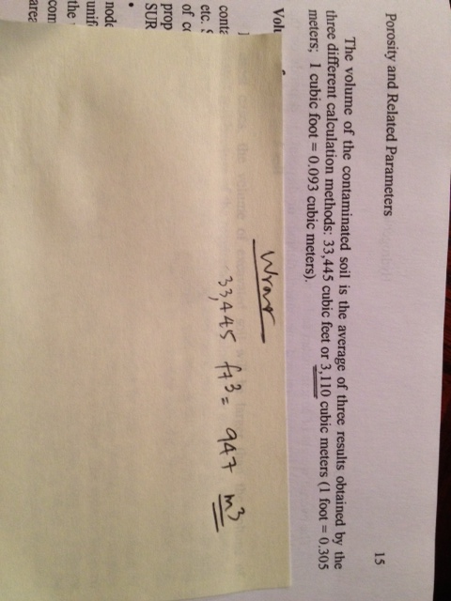
Volume and Weight Calculations

